Slide 1
Chapter Seventeen
Law Enforcement as an Occupation

Slide 2
Negative Aspects
Hours & Schedule
Financial
Physical
Emotional
Family Life

Slide 3
Hours & Work Schedule
Shift Work
Non-typical work week
Rotating Shifts
Seniority bid
Fatigue/Stress
Family Problems
Interferes with school or part time work

Slide 4
Financial
Most officers work part-time jobs
Negotiate with politically sensitive government leaders
Limited budgets/taxing ability
Threat of lawsuit

Slide 5
Physical
High risk of death or injury
Stress from danger and seriousness
Suicide rate greater than general population
Alcoholism
High blood pressure
Heart attack
High levels of adrenaline aid in degeneration of vital tissues.
Average life expectancy in U.S. is 76 years compared to law enforcement officers, 59 years.

Slide 6
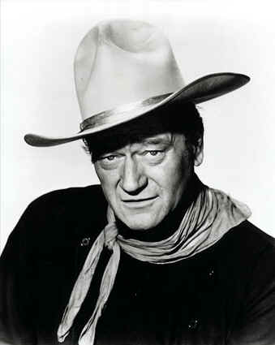
Emotional
Required to view and manage violent and graphic incidents
Investigates murder, rape, assault, child abuse
Trained to look for and see worst in people
Constant subject of attention, limits social contacts to other police officers
“John Wayne Syndrome”
Cynical, overly serious, emotionally withdrawn,
cold, authoritarian
Emotionless even when dealing with own family
Super Cop, 24/7

Slide 7
Family Life
Communication line with family closes for “protection”
Refuse to talk to spouse/partner about undesirable aspects of job
High rate of divorce
Controlling, demanding
Over-reacts to normal/experimental juvenile behaviors of own children
Overly harsh and restrictive

Slide 8
Positive Aspects
Variety
Community Contact
Accomplishments
Satisfaction
Respect

Slide 9
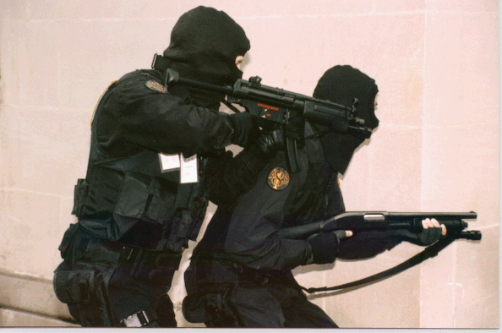
Variety
Wide variety of jobs and assignments (depends on size of department)
Nothing worse than working a “desk job”
Enjoy working non-typical hours

Slide 10
Community Contact
“People Business”
Person to person contact characterizes police work
Meet new people from all walks of life
Establish friendships and community contacts

Slide 11
Accomplishment
Follow case from beginning to end
Gather evidence, find suspect, take case to court, guilty conviction
Well planned search warrant or operation
Feeling of confidence and self worth

Slide 12
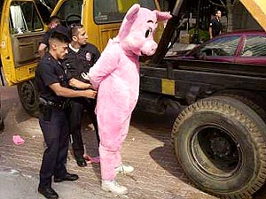
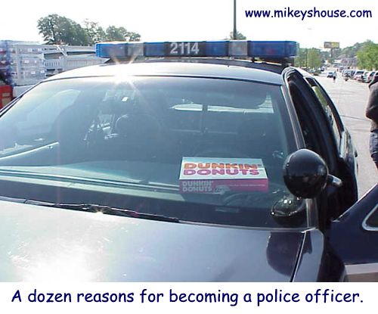
Satisfaction
Job is important
Helping to make society a better place
Saving a life
Defuse dangerous situation
Arrest criminals
Positive role model

Slide 13
Respect
Most people have respect for law enforcement
Law enforcement demands certain kind of individual

Slide 14
Job Opportunities
640,000 employed in federal, state, county, and city law enforcement.
Civilian staff positions
Equal opportunity for women

Slide 15
Minimum Qualifications and Testing
Citizenship
Character
Written Test
Physical Examination
Physical Agility Test
Psychological Assessment
Oral Interview
Certification
Application for employment

Slide 16
Citizenship
Must be citizen of the United States
In some cases, the officer must reside in the jurisdictional limits of their agency

Slide 17
Character
Background Investigation
Honesty
Integrity
Reputation
Credit Rating
Driving Record
Criminal History
Alcohol/Drug use
Any felony conviction
Crime involving dishonesty
Unlawful sexual conduct
Physical violence
Serious traffic offenses
Habitual breaking of laws

Slide 18
Written Test
Reading
Report writing
Grammar
Mathematics
Computer skills

Slide 19
Physical Exam
Vision
Hearing
Back problems
Evidence of future medical problems

Slide 20
Physical Agility Test
One minute | Male (age 21) | Female (age 21)
Push ups | 32 | 13
Sit ups | 44 | 34
Flexibility | 18 | 21
1.5 mile run | 12:15 | 14:56

Slide 21
Oral Interview
30 minute interview
Conducted by panel of administrators and supervisors
All applicants asked same questions
Oral communication skills, ability to analyze questions, reaction to pressure
Why do you want to be a police officer?
Could you shoot someone?
Tell us about a time you took a leadership role in a stressful situation
Have you ever violated a policy or rule and why?

Slide 22
Certification
440 hours (11 weeks) at P.O.S.T.
40 hours in-service training annually to maintain certification

Slide 23
Application for Employment
Age
Education
Pay scale and benefit package
Promotion possibilities
Geographical location
Primary law enforcement function
Size of agency
Agency policies
Outside employment
Use of vehicle
Residency requirements

