Slide 1
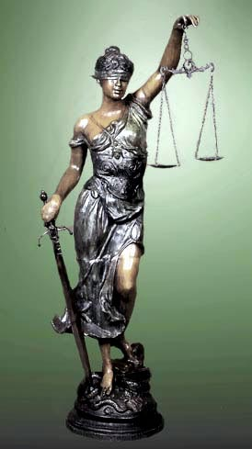
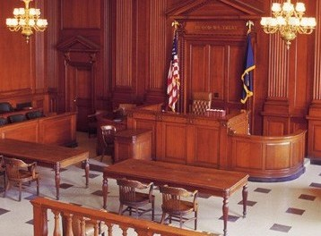
Chapter Six
TRIALS

Slide 2
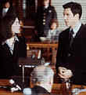
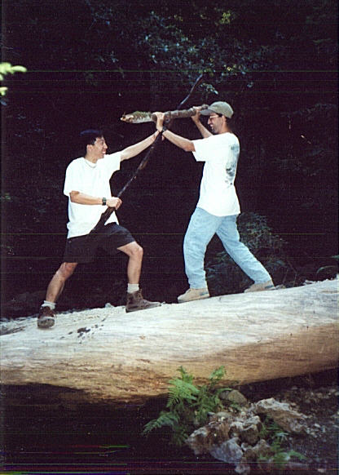
Trials in the U.S. utilize an adversarial system
There are two sides apposing each other.
The prosecution represents the state, city, or county
The defense represents the defendant(s)
If a person cannot afford an attorney, the U.S. Constitution guarantees defendants counsel at government expense. Usually public defenders.

Slide 3
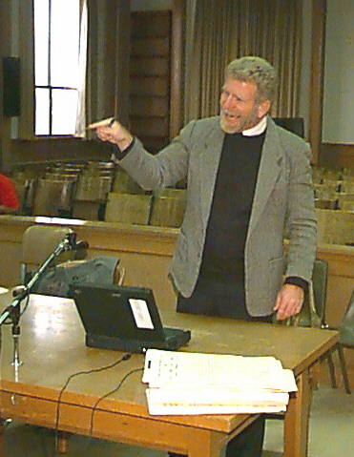
Roles of the Prosecution
Determine what, if any, law was violated
Determine if a case should be taken to court.
Prepare informations, summons, subpoenas.
Goes first at trial, presents evidence to prove guilt beyond a reasonable doubt
Negotiate plea bargains.

Slide 4
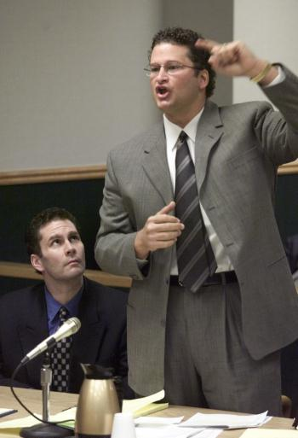
Roles of defense attorney
Work for the defendant. If they know, they may not reveal their client’s guilt. Act in client’s best interest.
Seek client’s release from jail or bail reduction.
Disprove prosecution’s case by locating witnesses/evidence to aid client. Argue for specific rulings.
Negotiate plea bargains.
Seek to minimize cost of conviction for client.

Slide 5
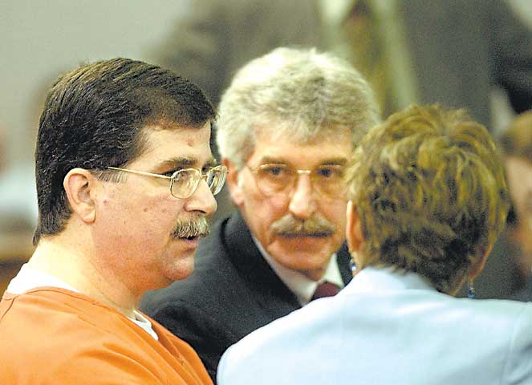
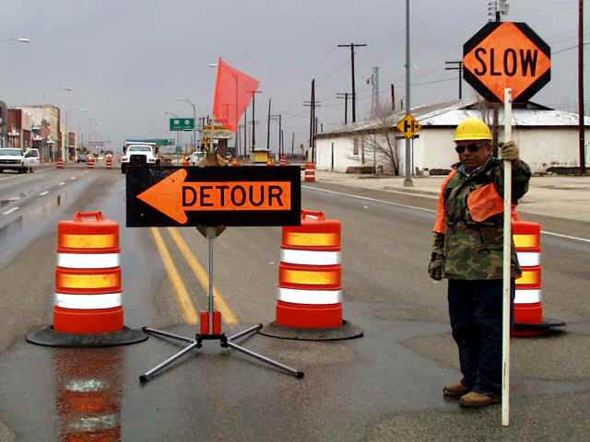
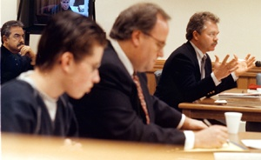
Plea Bargains
A plea bargain occurs when a judge allows a defendant to plead guilty to a lesser offense or fewer charges, or to arrange a lesser penalty in exchange for a guilty plea. The defendant benefits by minimizing penalty. The prosecution/ society benefits by saving time and money and getting a conviction on a weak case.

Slide 6
Cost of conviction
Jail or prison
Fine and/or restitution
Forfeiture, counseling, community service
Reduced employment opportunity
Ex-con label

Slide 7
An Information
An information is a legal statement specifying what law it is alleged that the defendant has violated and the details of the offense, such as the time, date, and location involved. An information may be filed before or after an arrest has been made.

Slide 8
The Trial Process
Though not all of the process we will discuss will apply to all trials, there are three crucial elements of the American criminal justice process.
A defendant is presumed innocent until proven guilty.
The burden of proof rests with the prosecution.
The trial activity itself must be fair.

Slide 9
Arraignment
At the arraignment the defendant is given a chance to enter a plea after being fully advised of the charges.

Slide 10
Discovery
In Jencks v. U.S., the Supreme Court stated that in order to ensure fairness, defense attorney can request copies of prosecution documents and reports, examine evidence, etc.

Slide 11
Suppression Hearing
If there is a question of legality regarding admissible evidence at a trial, the defense may request a suppression hearing. A judge will then review how the evidence was obtained. If it was illegally obtained, the exclusionary rule is applied to that piece of evidence and all evidence that resulted from it. It cannot be used or even mentioned in the trial.

Slide 12
Preliminary Hearing
A defendant is entitled to a hearing where the prosecution is required to present sufficient evidence before the judge to establish that there is probable cause to believe the a crime has been committed and that the defendant committed it. The defendant doesn’t have to testify and the defense does not have to present a case.

Slide 13
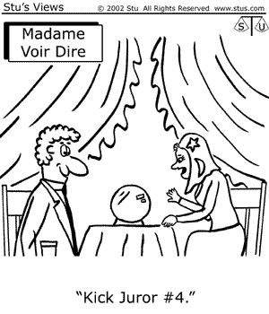
Jury Selection
The defendant chooses whether the trial is to be heard by a judge or a jury.
Voir dire examination is questioning of potential jurors. The judge or either attorney may dismiss unqualified jurors for cause
Possible questions may include:
Are you familiar with anyone involved with this case?
Have you been exposed to any pre-trial publicity?
Would you believe an officer’s testimony over a citizen’s?
Are you prejudiced against minorities?
In a homicide case, do you believe in capital punishment?

Slide 14
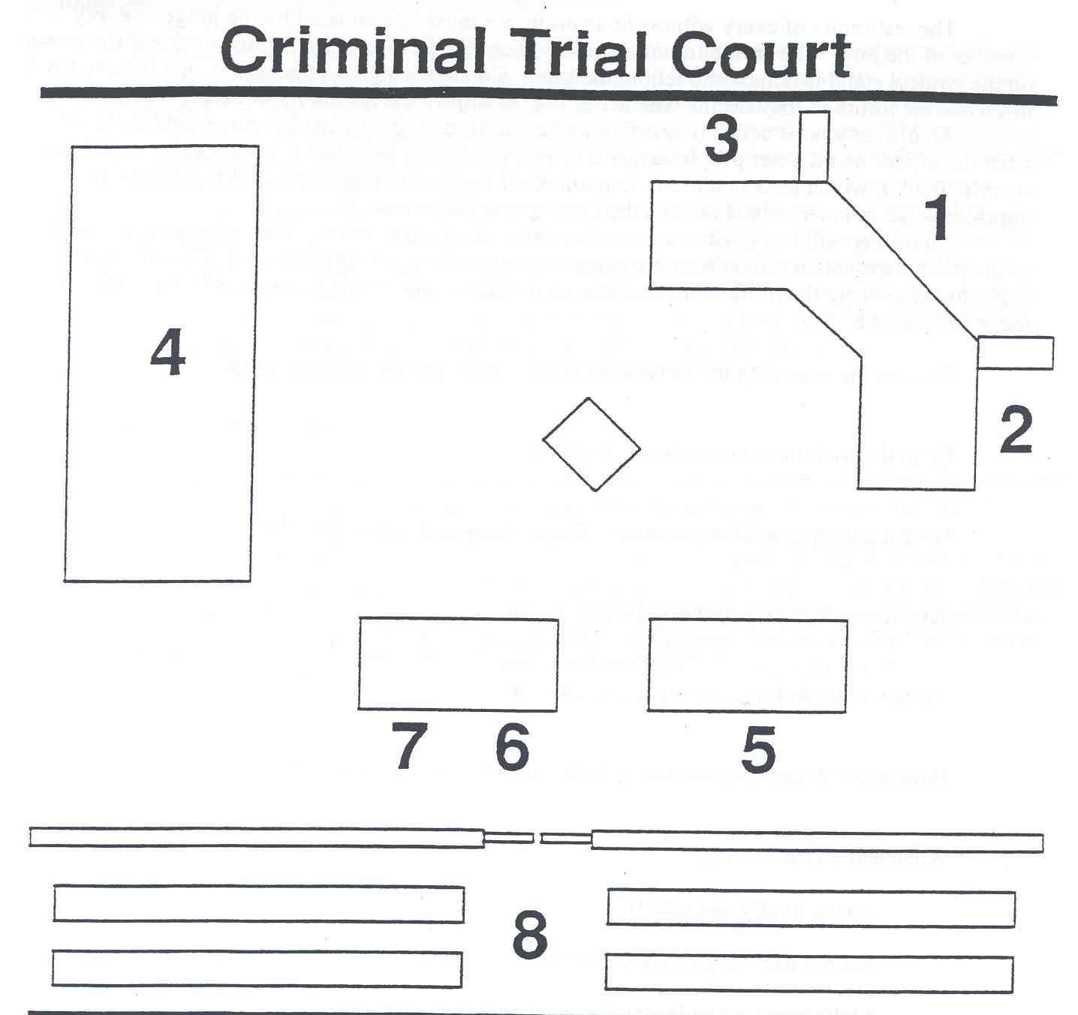
Criminal Trial Court
1. Judge
2. Clerk
3. Witness
4. Jury
5. Prosecutor
6. Defense Counsel
7. Defendant
8. Audience

Slide 15
The Trial
The actual trial begins with opening statements by both attorneys.
The prosecution, working from the position of strength, presents there case first and has the burden of proof.
The defense follows the prosecution.

Slide 16
Introducing Evidence
Evidence must be relevant, competent, and material to the facts of the case.
The judge decides if evidence has probative value in assisting the jury.
Evidence may be circumstantial, corroborative, or direct but must be admissible.
Either attorney may object to evidence or a line of questioning.
Law enforcement officers may refer to notes and reports when testifying
Only an expert witness may offer an opinion when testifying.

Slide 17
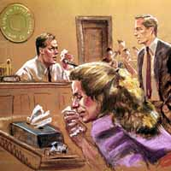
Who Has To Testify
To insure “Due Process”, the court will issue subpoenas requiring witnesses for the defense to appear.
A spouse cannot be required to testify against the other
Conversations with the defendant’s attorneys, doctors, or clergy cannot be used in court.

Slide 18
Testifying In Court
Review reports/notes and discuss the case with the prosecutor outside the courtroom.
Dress professionally.
Don’t laugh or joke.
Answer only the question asked.
Don’t guess.
Don’t use police jargon.
Don’t argue with the defense attorney.

Slide 19
Cross-Examination
After answering questions under direct examination, the opposing attorney then asks questions of the witness through cross-examination.
Questions must be limited to topics raised under direct-examination.

Slide 20
Affirmative Defenses
Alibi – defendant was some other place when the crime occurred.
Self Defense – the defendant's action were justified.
Insanity – At the time of the offense, the defendant didn’t know right from wrong due to mental illness
Entrapment – the police provided the opportunity AND motive for the defendant to commit the crime.

Slide 21
Closing Arguments
The prosecutor will be the first to make closing arguments.
Defense follows the prosecution.
The prosecution the gets the final word.

Slide 22
Jury Instructions
The Judges instructions will vary depending on the type of case. However, one common instruction is the jury must find the defendant guilt beyond a reasonable doubt.

Slide 23
Jury Deliberations
If after a lengthy period of time, a jury cannot make a unanimous decision, it becomes a hung jury.

Slide 24
Verdict
Guilty
Not Guilty
Not Guilty by Reason of Insanity.
Guilty and Mentally Ill.

Slide 25
Sentencing
The rules of evidence are not applicable.
AP&P prepares a presentencing report which will include aggravating and mitigating factors. (i.e. drug abuse, family history, juvenile record, etc.)

Slide 26
Appeal
A convicted defendant has the right to ask a higher court to review his/her trial record.
This does not require a new trial.
If an appeal is successful, the case is returned to the lower court.
Appeals are based on mistakes made by the court or new evidence.

Slide 27
Summary
The criminal trial process is weighted towards the defendant. He/She is presumed innocent until proven guilty beyond a reasonable doubt. A defendant is constitutionally guaranteed the assistance of an attorney. The system is meant to be slow and arduous so that justice is found in the end.

Slide 28
